Slide 1
SC First Steps 4K
The Building Blocks to Grow Your Business
Leadership Academy 2021
Presented By:
Samantha Ingram – SCFS 4K Outreach Coordinator, SC First Steps
Jessica Garrett – Account Director, 37 Gears
Alexis Short – Director of Strategy, 37 Gears

Slide 2
Welcome!

Slide 4
The Building Blocks:
Building Relationships
Community Engagement
Teacher Recruitment

Slide 5
:: Building Relationships

Slide 6
Q: What do people need that you can provide?
Notes:
How can your brand and service be part of the searching process for customers? Whether searching on your website or in browsers, people are searching because they are seeking information to do something .

Slide 7
Identify your difference
Map your unique points of difference to the needs of children and their families in your area.
Notes:
Your child care philosophy
Location
Payment methods
Your Staff - training and education

Slide 8
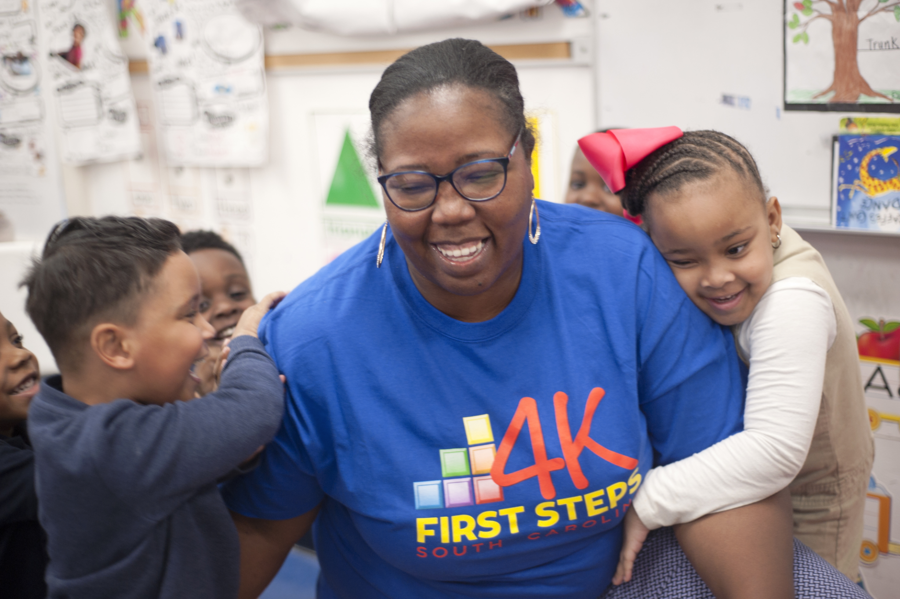
Differences to consider
Your child care philosophy
Location
Payment methods for families
Your Staff - training and education
Being a SC First Steps 4K provider
90 hours of development for teachers
Dedicated 4K coach
Research-based curricula and materials

Slide 9
2. Craft your Story
Develop a way to communicate your differences.
Notes:
Your story should be the cornerstone of all of your messaging. What you put together should also be authentic to the value you provide at your center.

Slide 10
Questions to ask to prepare your story
Why would a parent choose your center?
What makes your childcare center special?
What are the core services you offer?
Is there something you offer that your competitors don’t?
What do you want your center to be known for?
How do you think others would describe your center to their friends?
What do your students and their parents love most about your center?

Slide 11
3. Establish your Voice
Match attributes to the benefits of a child attending your center.
Notes:
Your story should be the cornerstone of all of your messaging. What you put together should also be authentic to the value you provide at your center.

Slide 12
Message Map
Supporting attribute
Supporting attribute
Supporting attribute
}
Attributes
(what we offer)
Your Center is...
Key Attribute
Core Value Proposition
Benefits
(why it matters)
So that...
Key Benefit
Supporting Benefit
Supporting Benefit
Supporting Benefit

Slide 13
Message Map
Prepare children to start kindergarten
Promote the value & benefits of a 4K program
Support working families
}
Attributes
(what we offer)
SC First Steps 4K is...
getting children ready for school, work and life
Core Value Proposition
Benefits
(why it matters)
So that...
all children can reach their highest potential
Children start school ready to learn
Children have a strong educational foundation that leads to long-term success in life
Strong support systems are established for children to thrive

Slide 14
4. Build Trust
One of the best ways to build trust with families is to show them exactly how their child is benefiting from being in your center. One of your best resources is the SC Profile of the Ready Kindergartener.

Slide 15
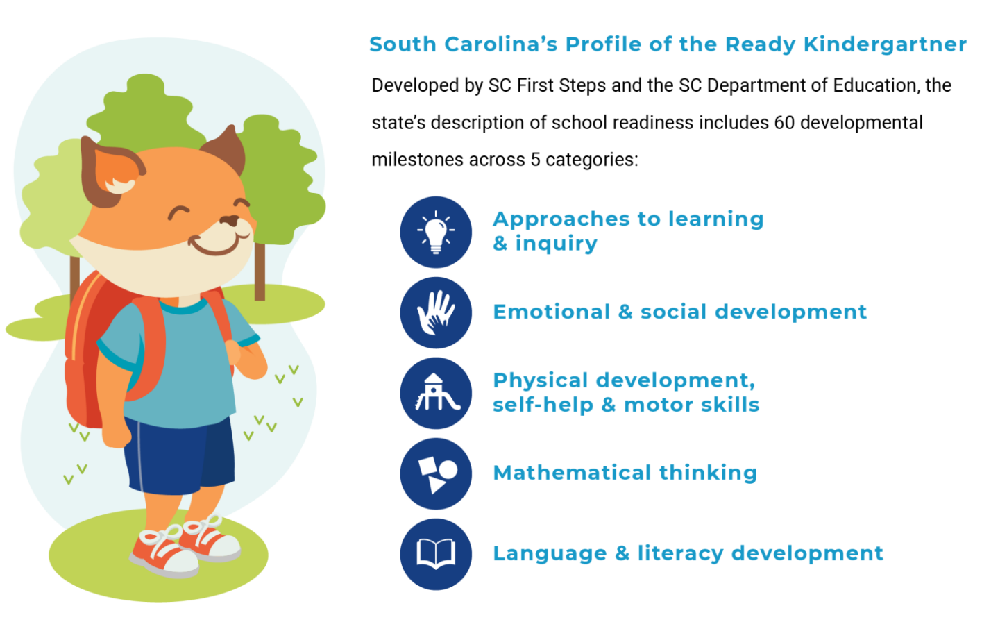
Building Trust
Share expectations from the beginning
Share what your students are learning
Share learning summaries in parent conferences that align to the SC Profile of a Ready Kindergartener
Approaches to learning & inquiry
Emotional & social development
Physical development, self-help & motor-skills
Mathematical thinking
Language & literacy development

Slide 16
Lifelong Benefits
TIP: Parents aren’t early learning experts like you are. Spell out how each activity helps their child meets the developmental milestones of the SC Profile of a Ready Kindergartner.

Slide 17
5. Focus on Service
Develop consistent communication with families.

Slide 18
Communication Techniques
Empathize with parents - If you’re dealing with a common issue, remind parents they aren’t alone and many other families have experienced similar situations.
Use the “sandwich approach” - “Sandwich” the difficult topic with two positive conversation points.
Don’t present a problem without a solution - Set the tone by preparing some potential solutions to share during your meeting.

Slide 19
5. Focus on Service
Continue to communicate how you are addressing developmental milestones with your services and providing value
1. Identify Your Difference
Map your offer to the needs of your customer base
Building Relationships
4. Build Trust
Create a feedback loop to ensure you are providing value to your families
2. Craft Your Story
Outline your unique points of difference
3. Establish Your Voice
Reiterate your offering in the same voice continuously to your customers

Slide 20
:: Community Engagement
Grassroots Techniques
Notes:
Overview
South Carolina First Steps to School Readiness oversees the state’s CERDEP 4K program in non-school district settings. In 2021, SC First Steps 4K is looking to expand its footprint across the state to ultimately increase the number of eligible children enrolled in a SC First Steps 4K child care provider program.
Objectives
Increase enrollment of children in participating SC First Steps 4K child care providers
Strategy
Identify SC First Steps 4K partners in those areas that have the largest deficit in meeting enrollment goals.
Focus on geographic areas in the state with the greatest need for First Steps 4k classrooms.

Slide 21
Community Engagement
Online
Add content to your Facebook Business page (1-3x/week)
Posts about relevant topics to parents
Images of your center and activities with the children
Reiterate milestones
Information about your program (ex. Time to register)
Join online parent groups in your community
Search Facebook for “childcare in <insert city name>”
Find others passionate about helping children and their families thrive
Professionals (ex. Early interventionists; speech therapists)
Local nonprofits that support children and families
Other SC First Steps 4K providers

Slide 22
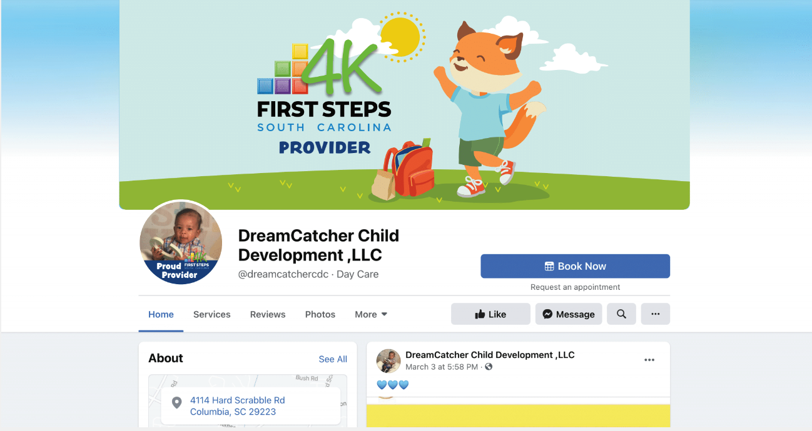
Facebook Profile Badge

Slide 23
Community Engagement
Offline
Host a parent workshop (help children thrive by helping families)
Gather testimonials from parents
Get involved in the business community
Rotary club
Local BBB chapter
Build community relationships
Pediatricians
Realtors
HR departments of local businesses
TIP: Post testimonials from parents on your social media and websites.

Slide 24
:: Teacher Recruitment
Ideas & Strategies

Slide 25
Teacher Recruitment
Online
Job posting sites
SC First Steps career page
Indeed: Posting a job on Indeed is free, and you can pay to boost your post.
Craigslist: Job posting fees vary based on the area you are targeting.
Glassdoor: If you pay to post a job opening on Indeed, it will automatically be shared on Glassdoor as well.
Monster: Monster charges monthly subscription rates but offers a free 7-day trial.
LinkedIn: You can pay to promote your job posting using a budget that you set.
Facebook Marketplace: You can post a job listing from your Facebook business page.

Slide 26
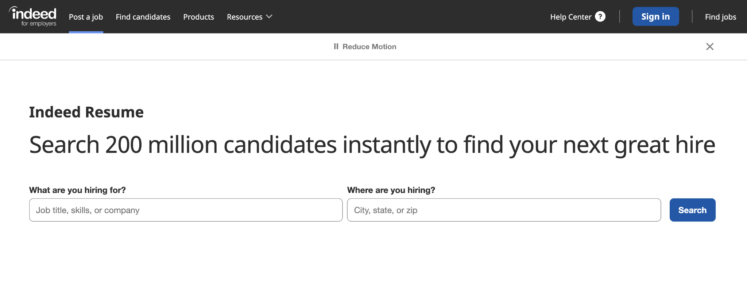
Be Proactive
Notes:
https://www.indeed.com/employers/resume-search

Slide 27
Teacher Recruitment
Offline
Signage at your location
Let your current families and others know you’re hiring
Referrals (Word-of-Mouth)
Current teachers & parents (develop a paid referral program & share it!)
Job Fairs
Local universities and technical colleges that offer Early Childhood Education degrees
Current Staff
Reach out to substitute teachers who you already love working with to see if they’d be interested in your openings.
TIP: Outline any incentives for employees in the job description (ex. employees receive a child care discount).

Slide 28
The Building Blocks
Building Relationships
Community Engagement
Teacher Recruitment
Practice your ABC's- Always
Be
Communicating
Activate local resources & online conversations
Diversify your teacher recruitment efforts
Identify your difference
Craft your story
Establish your voice
Build trust
Focus on service
Build your Facebook page
Join online parent groups
Connect with childcare professionals
Host a parent workshop
Join the business community
Build community relationships
Job posting sites
Signage
Referrals
Job Fairs at local universities and technical colleges
Current Staff

Slide 29
Q&A

