Slide 1
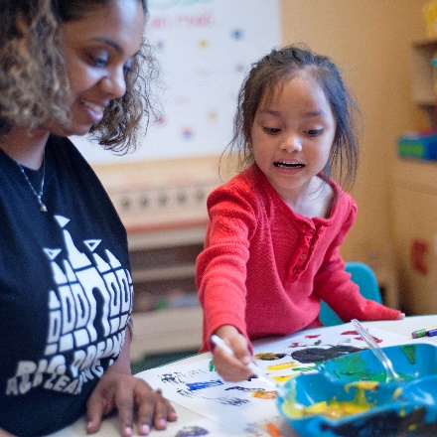
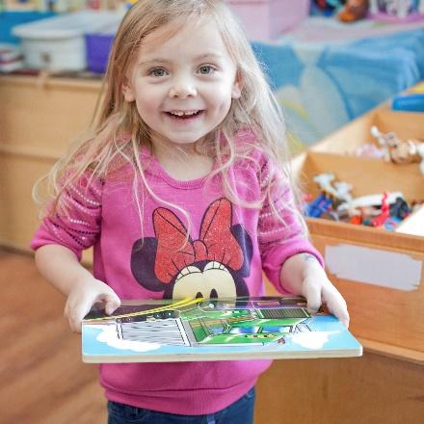
4K Family Orientation
[Enter 4K Provider’s School Name]
[Enter date of presentation]

Slide 2
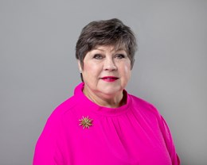
Message from 4K State Director
Welcome to our First Steps 4K Family! We’re excited to partner with you and your family to share the magic of early childhood education. By choosing a First Steps 4K early education school, you are giving your child the best start to their school days and future life. Every day paves the way!
-Martha Strickland

Slide 3
Our Goal
The goal of the South Carolina Child Early Reading Development and Education Program (4K) is to provide children and their families with the developmental and learning support necessary for school success.
Notes:
Provide families with a copy of the First Steps 4K family handbook.

Slide 4
What is First Steps 4K?
First Steps 4K classrooms are state-funded, public preschools in private early education schools which may be faith-based, charter schools, or licensed childcare. First Steps 4K is funded through SC's Child Early Reading Development and Education Program (CERDEP), as are 4-year-old programs in public schools. Parents have their choice of First Steps 4K classrooms with no district zoning .
All classrooms are curriculum driven and standards based. Eligible four-year olds are awarded an academic scholarship for the school year of either 180 or 220 days.
You get to choose which early education school best meets the needs of your family.
Notes:
To learn more about First Steps 4K visit www.scfirststeps.org.

Slide 5
What are families saying?
Since starting First Steps 4K, my child has learned so much, like the parts of a book! His vocabulary has grown tremendously, and it’s been amazing to see how confident he’s become- Aurora D.
Notes:
Quote from a 4K family about their student’s academic growth

Slide 6
As a 4K Provider
[Enter 4K Provider’s Name] works in partnership with First Steps 4K to ensure that all children start school ready to reach their highest potential. Families are a vital part of this mission.
Notes:
Add a picture of your school building on this slide.

Slide 7
Our School Family
Picture of
School Leader
Picture of
Lead Teacher
Picture of
Assistant Teacher
Picture of
4K Coach
[Enter Name]
[Enter Name]
[Enter Name]
[Enter Name]
Notes:
Enter a picture for each person. Picture of your 4K Coach can be found on the First Steps website (just copy and paste). Duplicate slide if you need to add more pictures of the school family to include others. Encourage families to bring a picture for friends & family board. You can talk about this more on Slide 7. Tell families the 4K ratio is 1:10 and what credentials your teacher has.
The culture of a school can build cooperation, willingness and responsibility. The School Family builds connections between families and schools, teachers and teachers, teachers and students, and students and students to ensure the highest development of all.

Slide 8
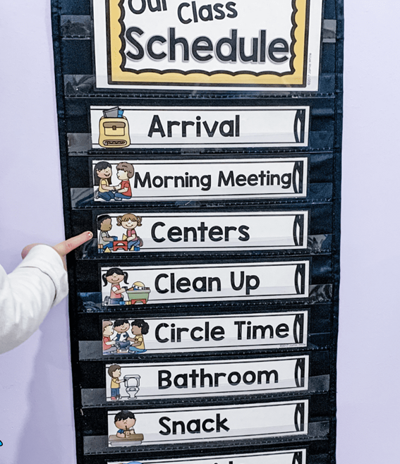
Day One
What Can You Do to Prepare
Practice bedtime routine a week early
Read a book about going to school
Ex. The Kissing Hand by Audrey Penn
Arrive early to meet the teacher and allow time for your child to transition.
Bring a family picture for the Family & Friends board
Bring a change of clothing (appropriate for the season)
Label your child’s belongings
Get familiar with the daily schedule
Notes:
Feel free to add other suggestions. A written list of Day One suggestions may be helpful for a first-time parent. Share a copy of the 4K Daily Schedule (6.5 or 8-hour day) and 4K School Calendar.
The first day of school is a bittersweet moment for many. It comes with some big emotions. Explain stagger start. Have a Meet & Greet, tour the classroom for a smoother transition. It’s helpful to know, how can I prepare for day one.
Create drop-off activities for families “sib and sob”. A place where families can leave a handwritten note or drawing for their child on day one. Offer facial tissue, juice, water, coffee. Some schools create a photo booth, an area for families to take Day One photos. Suggest bringing 2 family pictures- one for the child to keep and one that stays at school. Be prepared to take a picture on the spot for families who do not have photos.

Slide 9
Attendance Works!
According to research, absenteeism in the first month of school can predict poor attendance throughout the school year. 50% of students who miss at least 2 days the first month go on to miss nearly a month of school. Students who are in attendance regularly have better academic performance. First Steps 4K students may only miss a total of 10 days for the year.
Your 4K Day Begins at [enter time here]
Your 4K Day Ends at [enter time here]
*inquire about wraparound care
Your 4K student is tardy at {enter time here}
With the award of this academic scholarship, you are committing to having your student arrive on time every day.
If attendance challenges arise- contact the school!
Notes:
A welcoming environment is important to family engagement- from the parking to the building. Create a welcoming environment on the outside- flowers or décor. Greeting families by name and having signs in their home language. Do you have a family board where families can find information about what’s happening at the school? As families walk their children to the 4K classroom during arrival time, this creates trust and builds teacher-parent relationship. Morning arrival allows parents the opportunity to participate in classroom activities such as- Sign procedures and QOTD with their child.
On this slide also, discuss your departure protocols. Tardy is 30 minutes after the start time of your 4K Day. This may be different from your start and cutoff time for the overall school. Please explain the difference between your school policy and 4K. We are partners. Discuss options for wrap around care- before and after, as well as summer.

Slide 10
The Creative Curriculum
Notes:
First Steps 4K offers three curriculum options- Highscope, Montessori, and Creative Curriculum. We selected Creative Curriculum. It is a research-based model filled with investigations that encourages learning through play. Student’s growth is assessed using Teaching Strategies GOLD.
*If you are a Montessori program, fill free to edit this slide to reflect the Montessori Method.

Slide 11
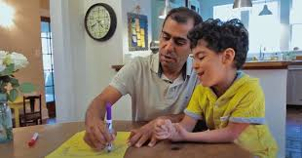
Support Learning at Home
Modeled Moment: Toy Stories (Language Development)
Parent Comment: He loved this activity; when it was his turn to retell the story, he had to make his own. I was so proud!- Charleston County
Notes:
As a part of your First Steps 4K academic scholarship, families will receive weekly modeled moments from Ready Rosie. These videos re less than two minutes and give you quick activities you can do at home to support your child’s learning. Join today! {click the family picture to show video or the YouTube link below}
https://youtu.be/dzifYyaEZXA?si=W3HuzUlvFbRF4l59
Additionally, families will receive quarterly family-teacher conferences to discuss student progress, two-family workshops one focused on literacy and the other focused on math, and much more. Families can also receive digital resources from Teaching Strategies- such as eBooks, home activities, shared family observations, and more.

Slide 12
Family Partnership Opportunities
Family Orientation or Open House
Ready Rosie
Teaching Strategies Family portal
Preschool Power Hour
Family Workshops with a Math or Literacy focus
WOW Experiences at the end of the studies
Quarterly Family Conferences w. Progress Reports
4K Family Newsletter
4K Family Survey
Volunteering
School events or celebrations
Countdown to Kindergarten
Notes:
Engagement takes place throughout the school year, this is all a part of successful transition to kindergarten and future academic success.
4K Providers will report attendance to the First Steps state office with the completed family engagement reflection form after each 4K orientation, conferences, and workshops for the school year. Don’t forget to sign in!

Slide 13
Notes:
You can add more about your school. Add a fun picture of teacher and a student. We are in it together, 4K Rocks!

Slide 14
First Steps 4K at Precious One Learning Center, Florence
First Steps 4K at A & A Learning Center,
West Columbia
First Steps 4K at A & A Learning Center, West Columbia
First Steps 4K at Hartman Hall Child Development Center, West Columbia

