Slide 1
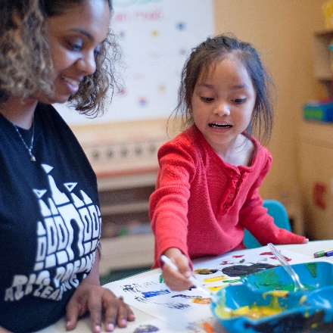
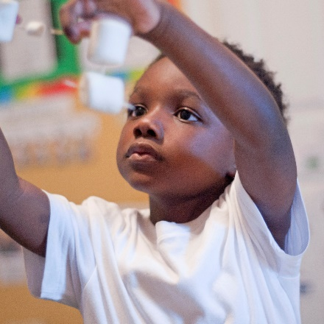
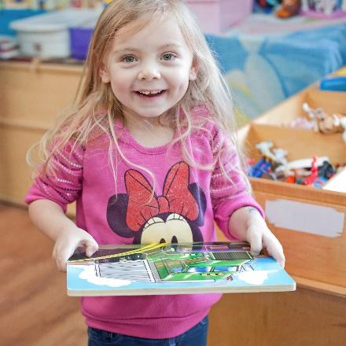
Tips for A Successful 4K Family Conference
Shayla Pettigrew, 4K Manager
Student & family services

Slide 2
Family-Teacher Conference
What is it?
It is a conversation between the child’s teacher and caregiver about his/her progress based on observations, anecdotal notes, and assessments.
Why is it important?
Building relationships with children and sharing observations with their families strengthens the connection between home and school. Regularly communicating with parents about their child’s development establishes trust and shared insight.
Notes:
Did you notice the term family-teacher conference? The definition of a traditional family has changed over the years. We know that the person who attends the conference may not be the primary guardian or biological parent- it could be a grandparent, aunt, uncle, or other caregiver.

Slide 3
Six Habits of Highly Engaged Programs
Principle 1: Programs invite families to participate in decision-making and goal setting for their child.
Principle 2: Teachers and programs engage families in two-way communication.
Principle 3: Programs and teachers engage families in ways that are truly reciprocal.
Principle 4: Programs provide learning activities for the home and in the community.
Principle 5: Programs invite families to participate in program-level decisions and wider advocacy efforts.
Principle 6: Programs implement a comprehensive program-level system of family engagement.
Notes:
It’s clear that parental involvement is associated with better outcomes. So how can early childhood education programs better engage with families? NAEYC’s Engaging Diverse Families Project set out to answer this very question, and they discovered that the programs with the most effective approaches to parent engagement shared six common principles.
Since parent engagement is at the heart of ASQ, by using the screener, your program is probably already encompassing many of these principles.

Slide 4
Family Engagement Plan
Family Engagement Plans include:
A family orientation at the beginning of the school year.
At least two parent/teacher conferences during which assessment data on the child’s progress must be shared.
At least two, Family workshops
Documentation of the parent(s)/guardian(s) efforts to participate.
Parent resources (a parent education resource library, regular newsletters, etc.)
Opportunities and written operating policies for ongoing parent involvement (volunteerism, classroom visits, etc.).
Notes:
Parents are a child’s first and most important teachers. Their involvement is critical to the success of their children. A family conference is one type of engagement. In addition to two parent/teacher conferences, the provider shall Sharing the parent handbook during orientation is essential part of developing a partnership between home and school. It indicates shared expectations. https://issuu.com/scfirststeps1/docs/4k_familyhandbook
Offer at least two parent education workshops during the school year. Documentation of these parent workshops, to include agendas and attendance records shall be maintained on-site, as shall documentation of all parent-teacher conferences.

Slide 5
Ages & Stages
When sharing results:
Review the results, emphasizing the child’s strengths.
Remind parents that screening does not diagnose a child
Use language such as well above cutoffs, close to cutoffs, and below cutoffs when explaining a child’s scores.
Listen to parents’ perceptions of their child and be open to new ideas and viewpoints.
If parents are interested, provide information about community resources and referral options.
Notes:
Once you have scored the questionnaires, share screening results in a strengths-based and family-friendly format. Highlight the child’s strengths in addition to areas for further support, and allow for any questions or discussion. Parents should be informed in person, over the telephone, or through mail or email that their child’s development seems typical. Follow-up screening should be scheduled for a child whose score falls in the monitoring zone.

Slide 6
What does an ideal conference look like?
Welcoming environment
Two-way communication
Strength based
Individual strategies
Plan for next steps and follow up
Notes:
Welcoming environment- comfortable seating, reading material, mask and sanitizer
Two way conversation- take turns talking and sharing information. Ask open-ended questions, this is an opportunity for you to share, but also an opportunity to learn something new.
Strength-based- What is the child able to do? Next steps
Individual strategies- share activities the family can do with their child.
Follow up- how do you plan to follow up?

Slide 7
Before the Conference
Establish location for conference
Finalize fall checkpoints
Generate report in TSG
Schedule conferences & invite families
Notes:
Finalize checkpoints, run progress report or develop family conference form, schedule conferences and send invitations. https://teachingstrategies.force.com/portal/s/article/Video-Creating-Family-Conference-Forms-in-MyTeachingStrategies

Slide 8
During the Conference
Use clear and positive language
Be an active listener
Provide them with questions to ask
Notes:
Examples of strength based. Activities the caregiver can use for their individual child. Give families questions they can ask you? See attachment

Slide 9
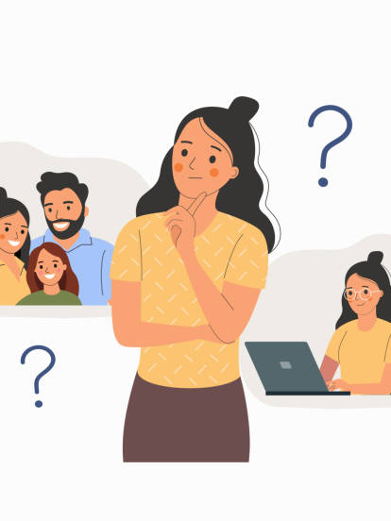
What questions can families ask you?

Slide 10
After the Conference
Notes:
File reports, check in with families, send documents to coach

Slide 11
Resources
4K Family Handbook
Ready Rosie conference checklist
Family-teacher conference form
Teaching Strategies reports and forms
ReadyRosie family conference invitations
Notes:
File reports, check in with families, send documents to coach

Slide 12
Questions?
Notes:
File reports, check in with families, send documents to coach

