Slide 1
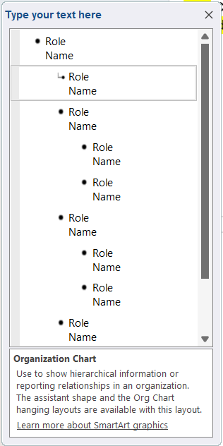
ABC County First Steps
as of date
Role
Name
Role
Name
Role
Name
Role
Name
Role
Name
Role
Name
Role
Name
Role
Name
Role
Name
Role
Name
Role
Name
This is a SmartArt Graphic in PowerPoint
To edit, click on org chart and this dialogue box will appear:
Edit the text in this box to add in the titles and names of the people in your organization
If they are full-time, include (FT) next to their role
If they are part-time include (PT) next to their role
If they are an independent contractor include an asterisk (*) next to their role
(FT) = full-time; (PT) = part-time; (*) = independent contractor

Slide 2
Example County First Steps
as of March 5, 2025
Executive Director (FT)
Dolly Parton
Office Assistant (PT)
Kermit the Frog
Child Care Program Director (FT)
Big Bird
Parent Educator (FT)*
Oscar the Grouch
Parent Educator (FT)
Count Dracula
Child Care Technical Assistant (FT)
Bert
Child Care Technical Assistant (PT)
Ernie
(FT) = full-time; (PT) = part-time; (*) = independent contractor

Slide 3
ABC County First Steps
as of date
Role
Name
Role
Name
Role
Name
Role
Name
Role
Name
Role
Name
Role
Name
Role
Name
Role
Name
Role
Name
Role
Name
(FT) = full-time; (PT) = part-time; (*) = independent contractor

