Slide 1
Your Child Matters.
School Readiness Matters.
4K Family Orientation 2026-2027
[Enter 4K Provider’s School Name]

Slide 2
As a 4K Provider
We are committed to working in partnership with First Steps 4K. In recent analysis, we learned that 74% of children who achieved ‘demonstrated readiness’ on SC’s kindergarten readiness assessment (KRA) also achieve 3rd grade reading and math benchmarks.
Notes:
Enter a picture of your school.

Slide 3
Our School Family
[Enter pictures of your staff]

Slide 4

Supporting Your Child At Home
Read books about starting school.
Bring a family picture for the family board.
Bring a change of clothing
Review and talk about the daily schedule
Appropriate sleep schedule
Watch a ReadyRosie Modeled Moment weekly.
Click on the ReadyRosie logo to watch the welcome video.

Slide 5
Attendance Matters
Consistent attendance helps your child build routines, relationships, and confidence.
Make sure your child attends school daily.
First Steps 4K policy states that students who miss more than 10 unexcused days of school will lose their tuition.
Your 4K Day Begins at [enter time here]
Your 4K Day Ends at [enter time here]
*inquire about wraparound care
Your 4K student is tardy after {enter time here}

Slide 6
Partnering with Families
3 Family-Teacher Conferences
2 family engagement workshops
1 ReadyRosie video each week
ASQ-3 Questionnaire completed within the first 45 days of school.
Please sign that you participated in this orientation.
If you have ideas, suggestions, or questions about First Steps 4K program, email us at Free4K@scfirststeps.org.

Slide 7
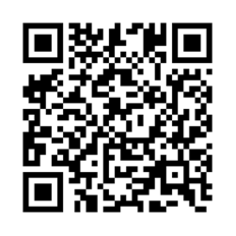
Preschool Power Hour
This virtual event was held on July 15th. Scan the QR code or click the link to access the recording. YouTube link: https://youtu.be/xcOOQB92Aa0

